Slide 1

Topic 5: Data Transformation with dplyr – Part 1

Slide 2
Course Overview
Topic | Description
Session 1
1 | Introduction to R and R Studio Cloud
2 | Exploratory Data Analysis: the tibble and ggplot2
3 | Functions, Vectors and Lists
4 | Introduction to Functionals with purrr
5 | Data Transformation I with dplyr
Session 2
6 | Data Transformation II with dplyr
7 | Statistical Transformation with ggplot2
8 | Advanced Functionals and Modelling with purrr
9 | Exploratory Data Analysis - Case Study using aimsir17

Slide 3
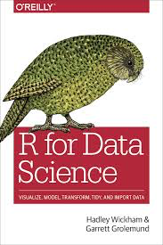
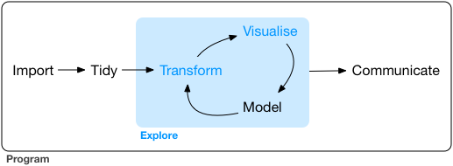
Overview
Visualisation is an important tool for insight generation, but it’s rare that you get the data in exactly the right form you need (Wickham and Grolemund 2017)
Create new variables
Create summaries
Order data
dplyr package is designed for data transformation

Slide 4
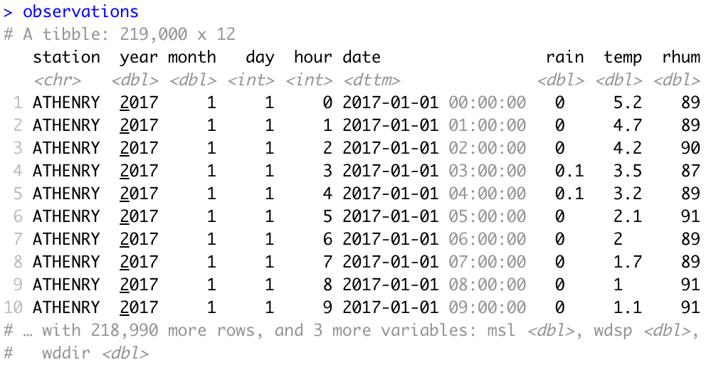
Recap - Data Frames/Tibbles
The most common way of storing data in R
A two-dimensional structure, with rows (observations) and columns (variables)

Slide 5
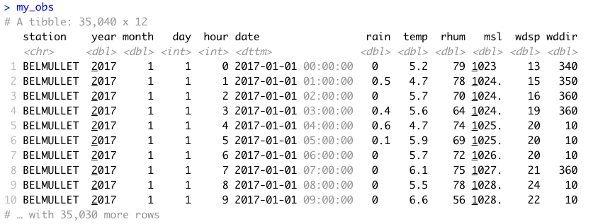
aimsir17

Slide 6
dplyr Basics: 5 key functions
Function | Purpose
filter() | Pick observations by their values
arrange() | Reorder the rows
select() | Pick variables by their names
mutate() | Create new variables with functions of existing variables
summarise() | Collapse many values down to a single summary
”A grammar of data manipulation”
All verbs (functions) work similarly
The first argument is a data frame/tibble
The subsequent arguments decide what to do with the data frame/tibble
The result (data frame/tibble) supports chaining of steps – NOTE the “pipe operator” which we will cover later.
https://dplyr.tidyverse.org

Slide 7
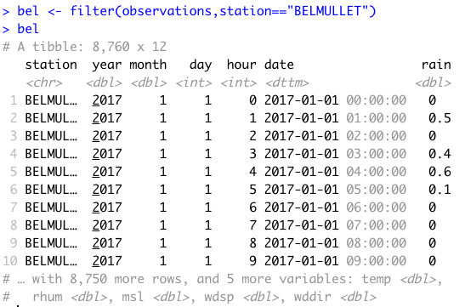
1. filter()
First argument the name of the data frame
Subsequent arguments are expressions that filter the data frame
Subsequent arguments can be viewed as a succession of “and” statements
Number of columns does not change
Number of rows reduced (filtered)

Slide 8
Relational operators in R
Operators | Description
< | less than
<= | less than or equal to
> | greater than
>= | greater than or equal to
== | exactly equal to
!= | not equal to
!x | not x
x | y | x OR y
x & y | x AND y

Slide 9
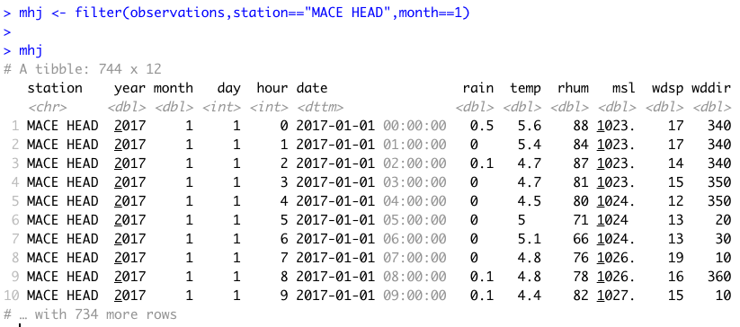
Show rows for “MACE HEAD” in January

Slide 10
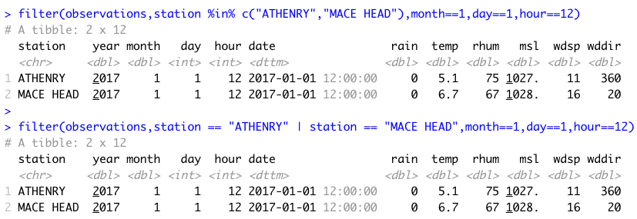
Useful approaches for filtering more than one value
%in% operator in R

Slide 11
Challenge 5.1
Show the weather for “ROCHES POINT” on October 16th at 12 midday

Slide 12
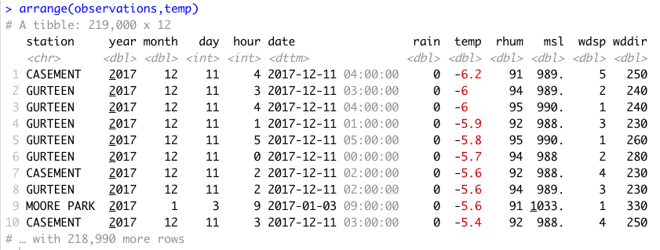
2. arrange()
Changes the order of rows.
Used for sorting values
Takes a tibble and a set of column names to order by

Slide 13
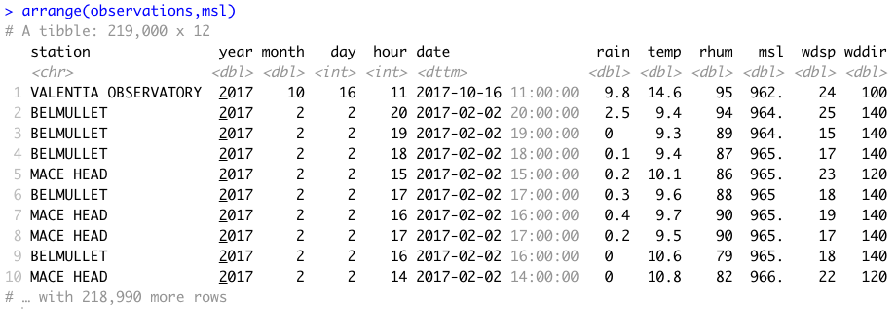
Mean Sea Level Pressure

Slide 14
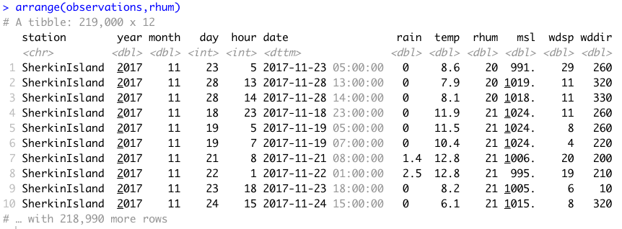
Humidity

Slide 15
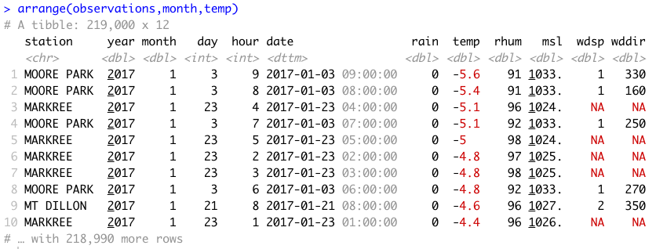
More than one value

Slide 16
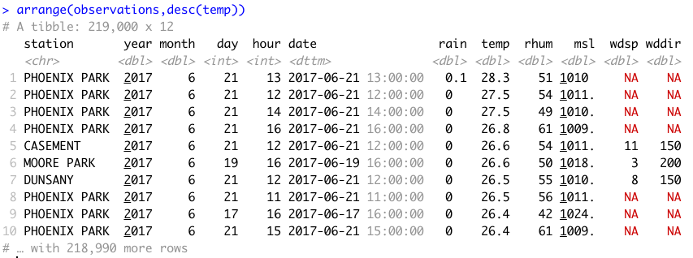
In descending order - desc()

Slide 17
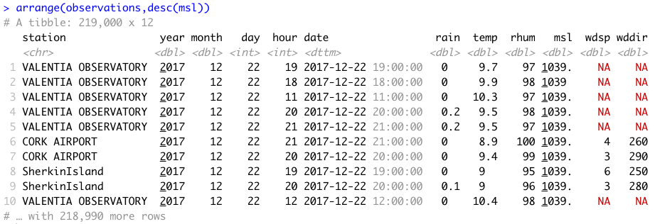
Mean Sea Level Pressure

Slide 18
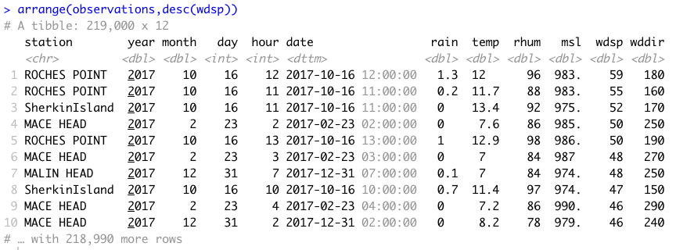
Windspeed

Slide 19
Challenge 5.2
Arrange the observations by month and by highest temperature

Slide 20
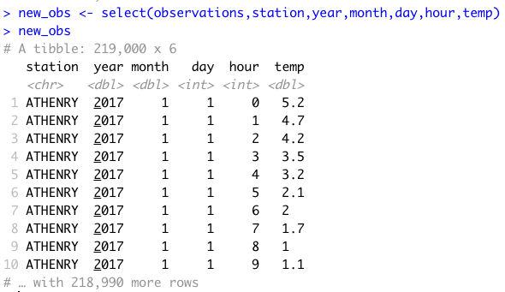
3. select()
It is not uncommon to get datasets with hundreds, or even thousands, of variables
A challenge is to narrow down on the variables of you’re interested in
select() allows you to rapidly zoom in on a useful subset using operations based on the variable names
Number of rows does not change

Slide 21
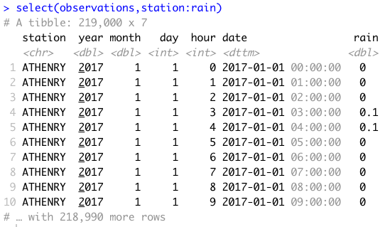
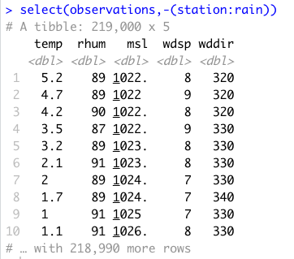
Useful options with select()

Slide 22
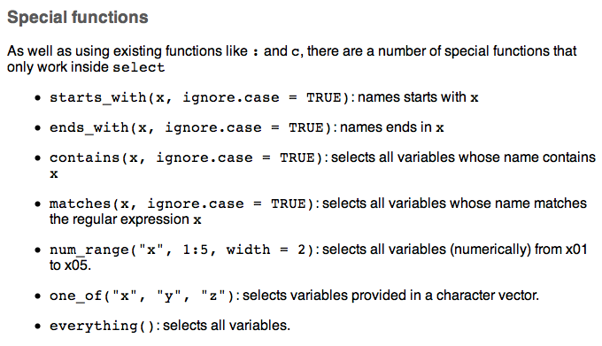
Special functions with select()

Slide 23
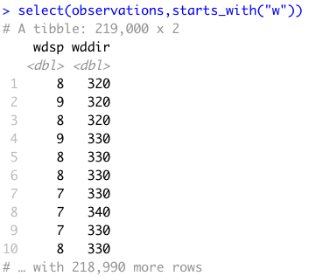
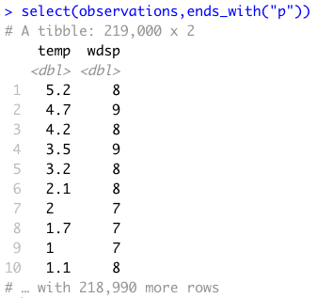
Examples

Slide 24
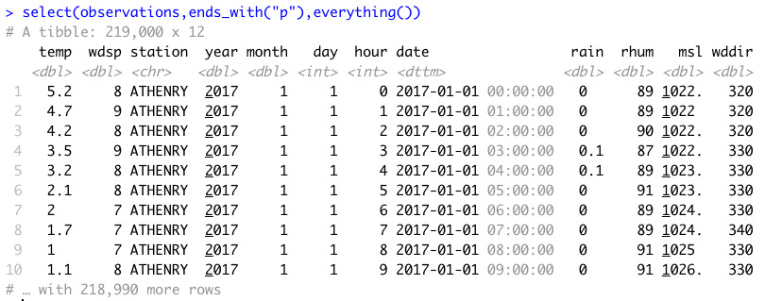
everything()

Slide 25
Summary: 3 of the 5 verbs
Function | Purpose
filter() | Pick observations by their values
arrange() | Reorder the rows
select() | Pick variables by their names
mutate() | Create new variables with functions of existing variables
summarise() | Collapse many values down to a single summary
”A grammar of data manipulation”
All verbs (functions) work similarly
The first argument is a data frame/tibble
The subsequent arguments decide what to do with the data frame/tibble
The result (data frame/tibble) supports chaining of steps – NOTE the “pipe operator” which we will cover later.
https://dplyr.tidyverse.org

Slide 26
Challenge 5.3
Create tibble one that has the columns month, hour, day, date, station and msl
Filter the tibble to a second tibble for October 16th, and for “VALENTIA OBSERVATORY” and “DUBLIN AIRPORT”
Display the hourly values on a time series (x axis is date) using ggplot2 with the aesthetic set to station

Slide 27
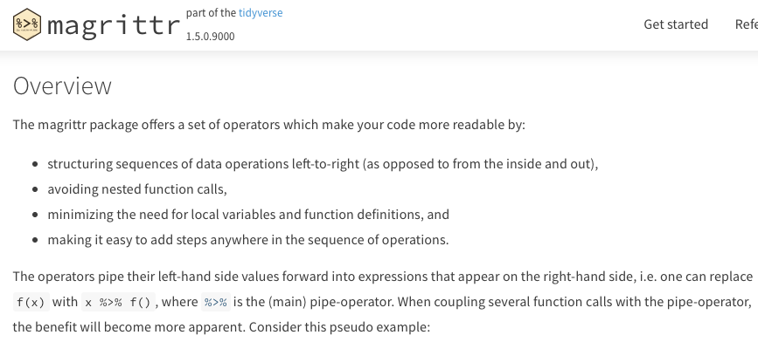
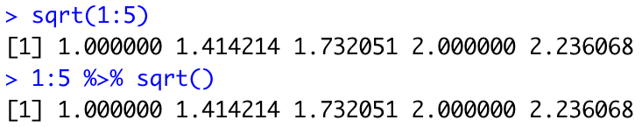
Combining operations with the Pipe
The pipe %>% comes from the magrittr package (Stefan Milton Bache)
Helps to write code that is easier to read and understand
x %>% f(y) turns into f(x, y)
x %>% f(y) %>% g(z) turns into g(f(x, y),z)
https://magrittr.tidyverse.org

Slide 28
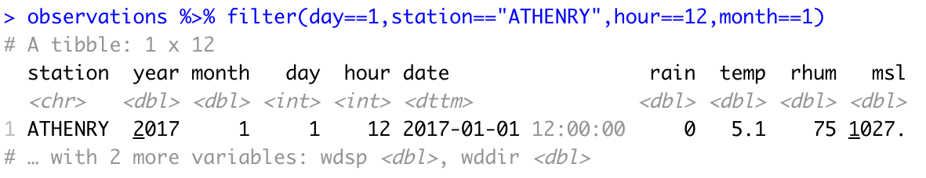
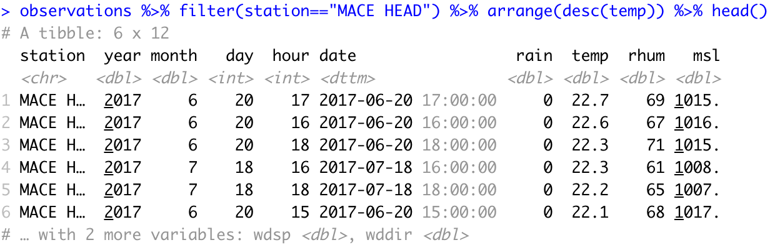
Examples

Slide 29
dplyr Basics: 5 key functions
Function | Purpose
filter() | Pick observations by their values
arrange() | Reorder the rows
select() | Pick variables by their names
mutate() | Create new variables with functions of existing variables
summarise() | Collapse many values down to a single summary
”A grammar of data manipulation”
All verbs (functions) work similarly
The first argument is a data frame/tibble
The subsequent arguments decide what to do with the data frame/tibble
The result (data frame/tibble) supports chaining of steps – NOTE the “pipe operator” which we will cover later.
https://dplyr.tidyverse.org

Slide 30
4. mutate()
It is often useful to add new columns that are functions of existing columns
mutate() always adds new columns at the end of your data set.
For example, convert the mph wind speed in observations to a new column, kph.
Use a simplified observations tibble with day, month, station, wdsp as columns, and for “ROCHES POINT” on October 16th
Assume 1 mi = 1.609344 km

Slide 31
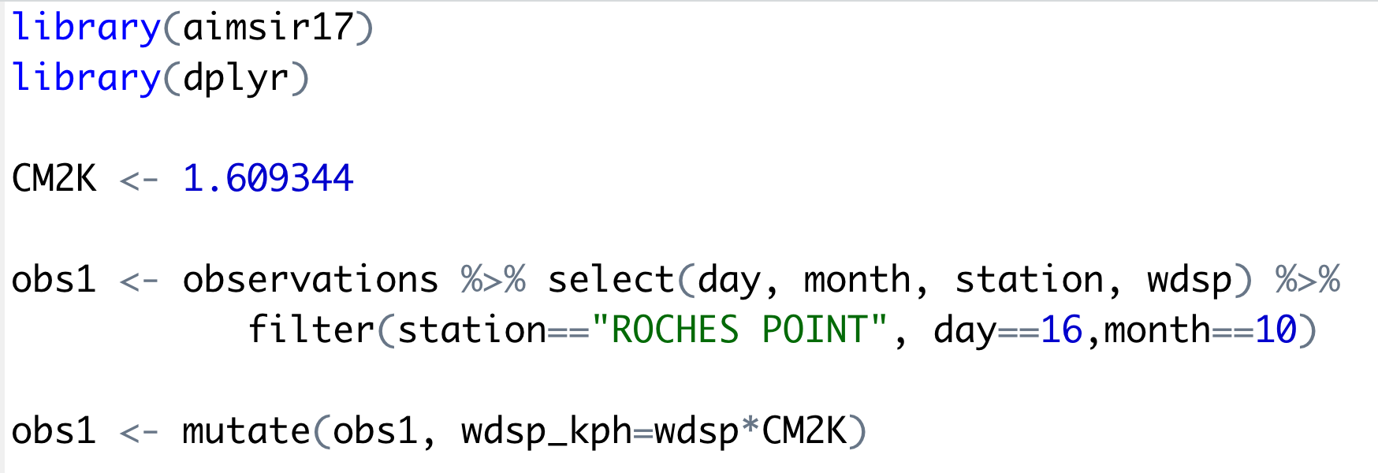
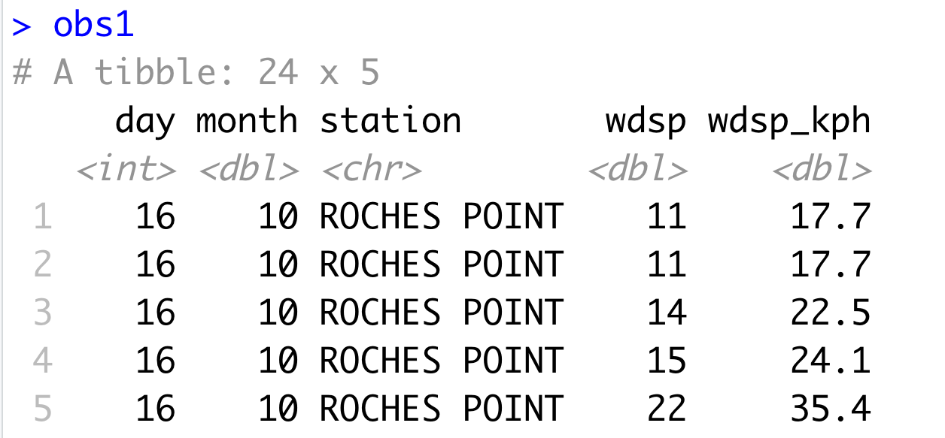
Example of mutate

Slide 32
Useful Creation Functions
There are many functions for creating new variables that can be used with mutate()
The key property is that the function must be vectorised:
It must take a vector of values as input, and,
Return a vector with the same number of values as output

Slide 33
Challenge 8.1
Add a new column rain_in, which measures the hourly rainfall in inches
Assume a conversion constant of 1 mm = 0.0393701 inches

Slide 34
dplyr Basics: 5 key functions
Function | Purpose
filter() | Pick observations by their values
arrange() | Reorder the rows
select() | Pick variables by their names
mutate() | Create new variables with functions of existing variables
summarise() | Collapse many values down to a single summary
All verbs (functions) work similarly
The first argument is a data frame
The subsequent arguments decide what to do with the data frame
The result is a data frame (supports chaining of steps)

Slide 35
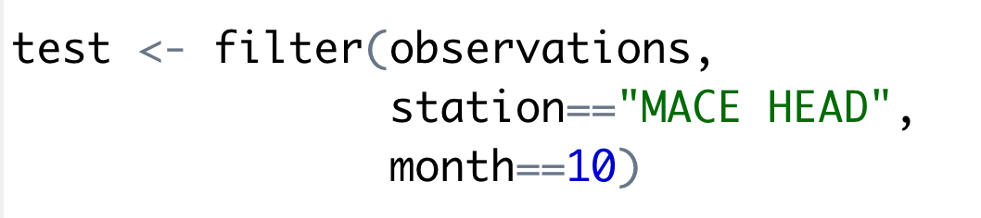
5. summarise()
The last key verb is summarise()
It collapses a data frame into a single row
Not very useful unless paired with group_by()
Very useful to combine with the pipe operator

Slide 36
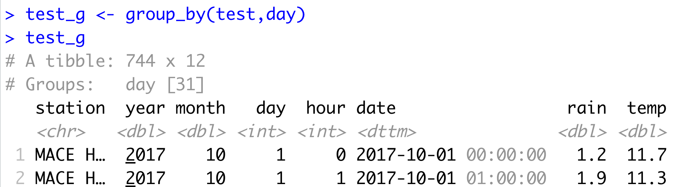
group_by()
Most data operations are useful done on groups defined by variables in the the dataset.
The group_by function takes an existing tbl and converts it into a grouped tbl where operations are performed "by group”.

Slide 37
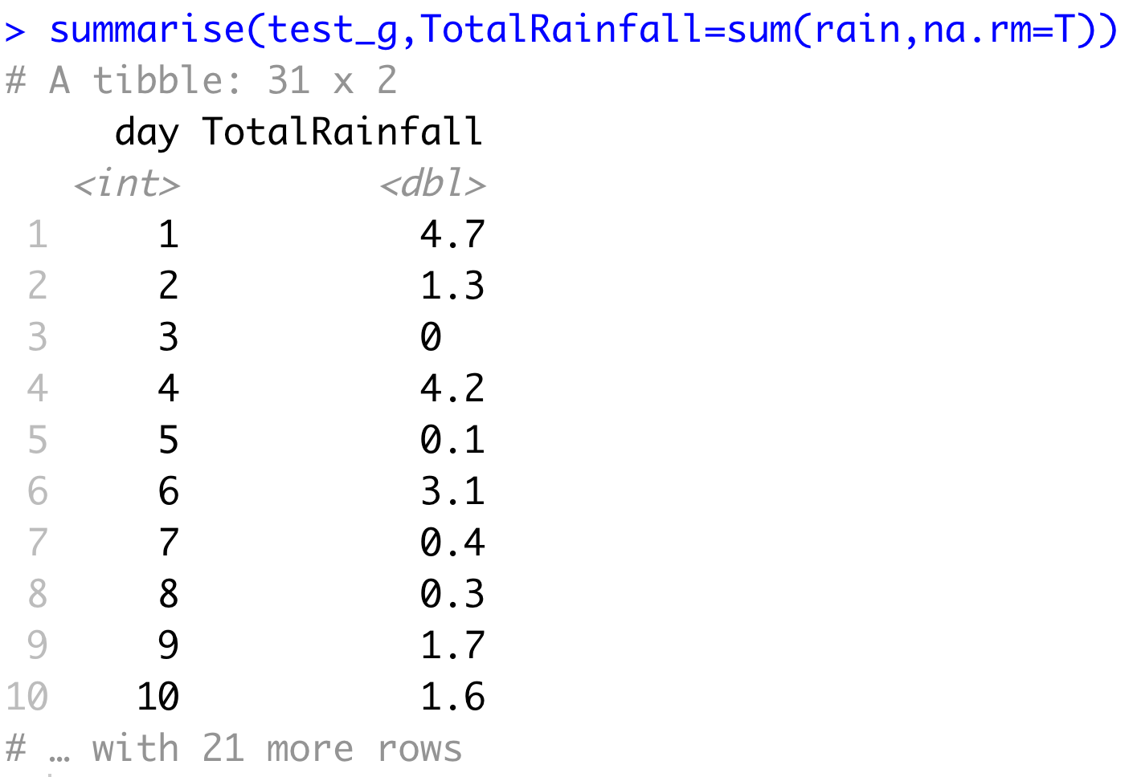
Key idea
This grouping can then be exploited by summarise

Slide 38
Overall idea…
Original data frame
Grouped data frame
group_by()
summarise()

Slide 39
Useful Summary Functions
Grouping | Examples
Measures of location | mean(), median()
Measures of spread | sd(), IQR(),mad()
Measures of rank | min((), quantile(), max()
Measures of position | first(), nth(), last()
Counts | n(), n_distinct()
Counts and proportions of logical values | sum(x>0) when used with numeric functions, (T,F) converted to (1,0)

Slide 40
Challenge 8.2
For “BELMULLET” calculate the total daily rainfall for October, and show using ggplot.

Slide 41
dplyr Summary: 5 key functions
Function | Purpose
filter() | Pick observations by their values
arrange() | Reorder the rows
select() | Pick variables by their names
mutate() | Create new variables with functions of existing variables
summarise() | Collapse many values down to a single summary
”A grammar of data manipulation”
All verbs (functions) work similarly
The first argument is a data frame/tibble
The subsequent arguments decide what to do with the data frame/tibble
The result (data frame/tibble) supports chaining of steps – NOTE the “pipe operator” which we will cover later.
https://dplyr.tidyverse.org

Slide 42
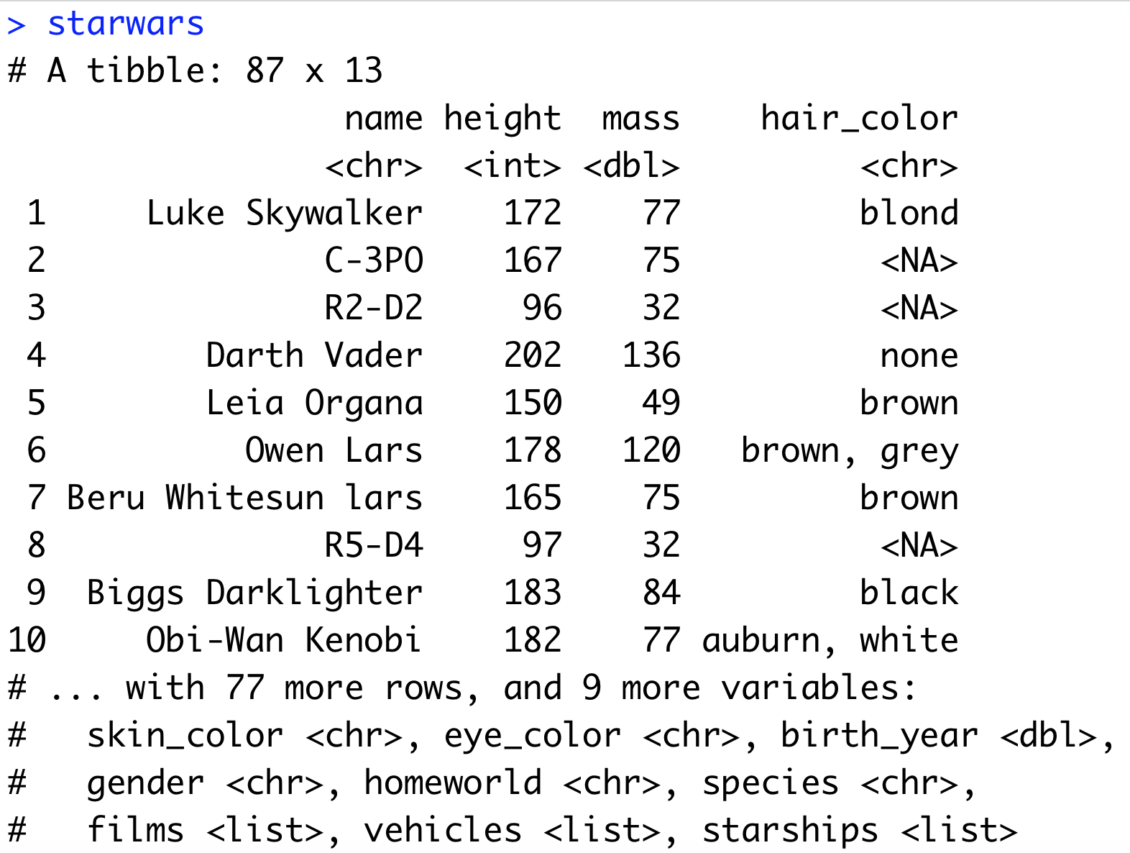
dplyr 0.7.0, some new additions
Two new data sets: starwars and storms
pull() verb
case_when(), valuable for mutate operations instead of nested ifs

Slide 43
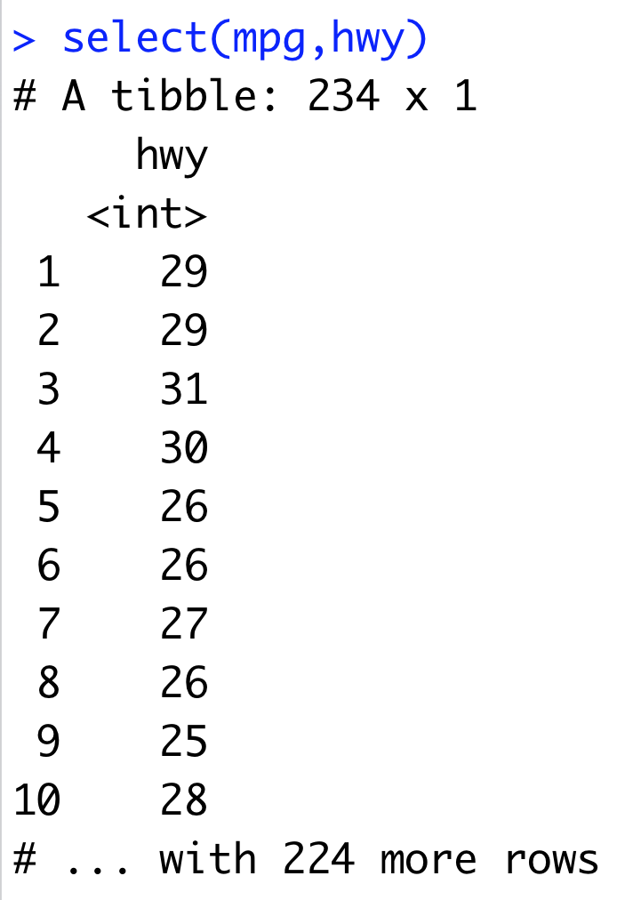
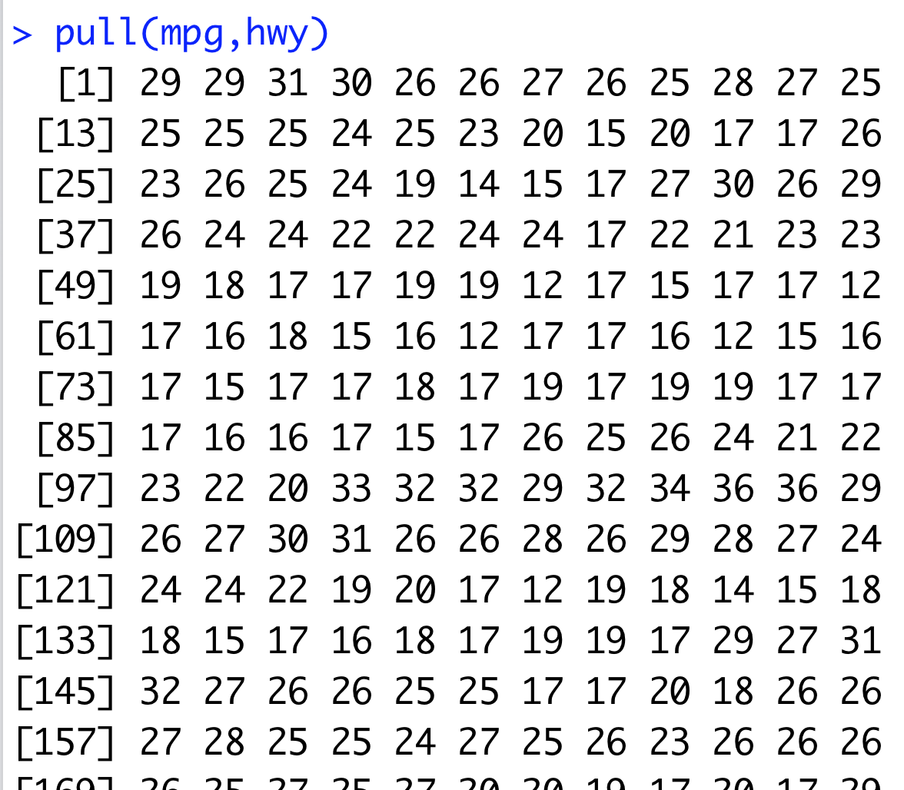
pull() – Select 1 column as a vector

Slide 44
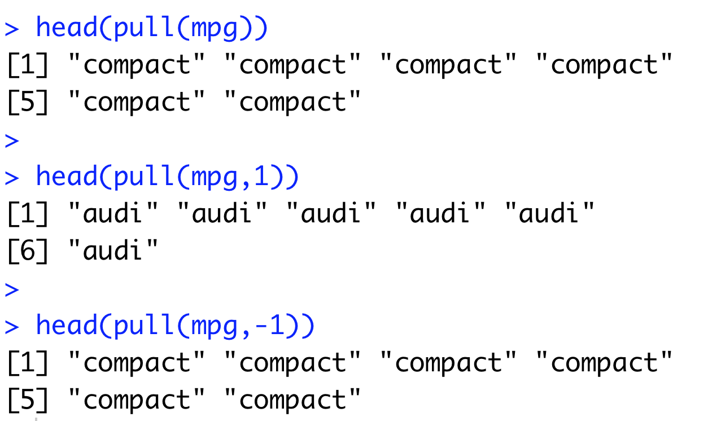
pull() – Also works with column numbers, default is last column

Slide 45
case_when()
This function allows you to vectorise multiple if and else if statements. It is an R equivalent of the SQL CASE WHEN statement. Arguments:
A sequence of two-sided formulas. The left hand side (LHS) determines which values match this case. The right hand side (RHS) provides the replacement value.
The LHS must evaluate to a logical vector. Each logical vector can either have length 1 or a common length. All RHSs must evaluate to the same type of vector.
Proceed from the most specific to the most general

Slide 46
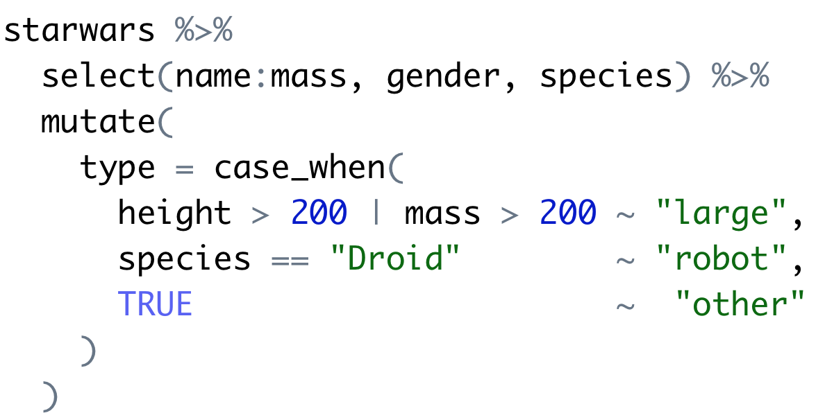
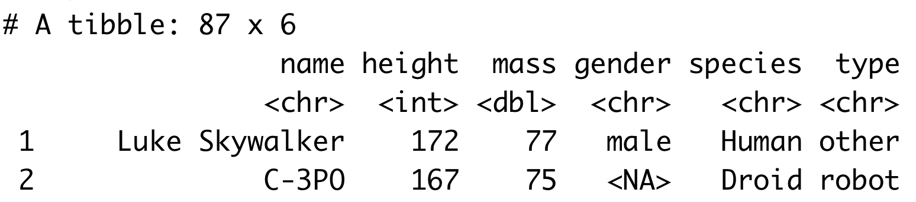
Very useful in mutate()

